Slide 1


Slotted Random-Access Wireless Network
TOMMASO BURLON
Francesco Iemma
Olgerti xhanej
Notes:
1

Slide 2
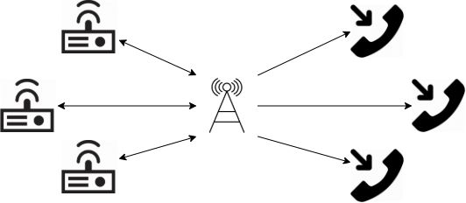
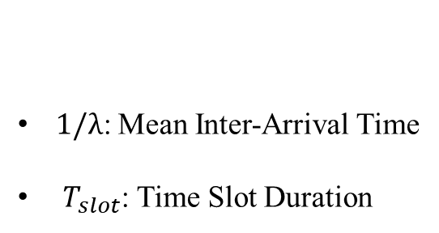
Modelling
General Assumptions
Transmission at the beginning
Constant Packet Size
No Propagation Error
Unbounded Queues
Tx/Rx Synchronization
Collisions and Channel Choice
N: Transmitter/Receiver Couples
C: Number of Channels
p: Sending Probability
1/λ: Mean Inter-Arrival Time
$T_{slot}$: Time Slot Duration
Factors

Slide 3
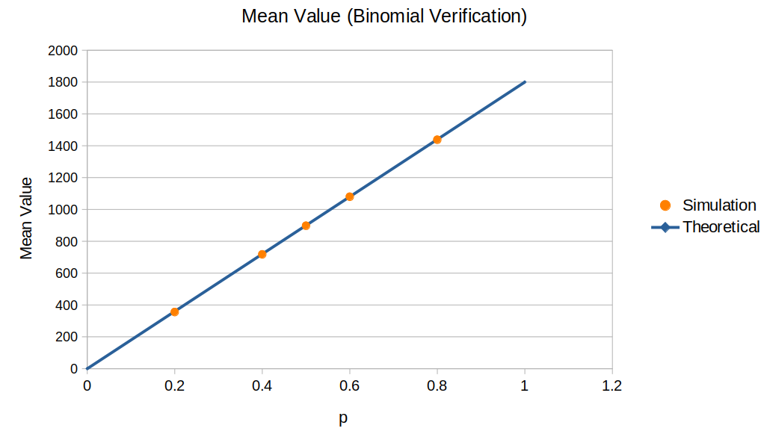
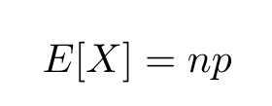
Verification (1)
Tests Performed
Continuity Test
Consistency Test
Degeneracy Test
Binomial Model
Collision Model
Binomial Model
N=1; C=1; 1/λ = 1s; p = {0.05, 0.1, 0.15, 0.2, 0.4, 0.5, 0.6, 0.8}

Slide 4
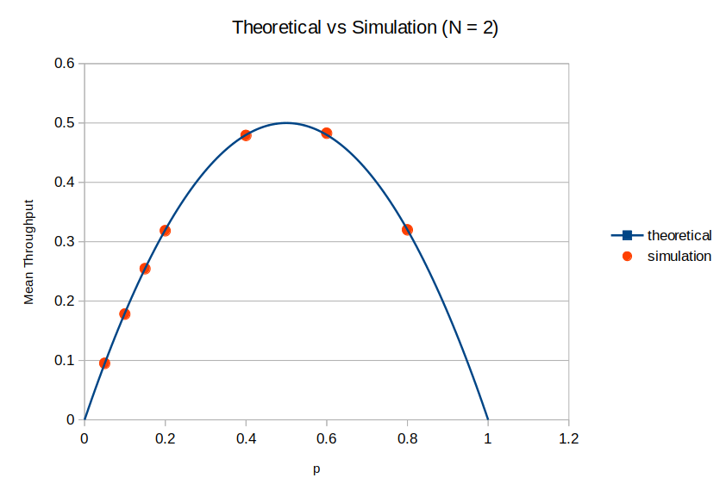
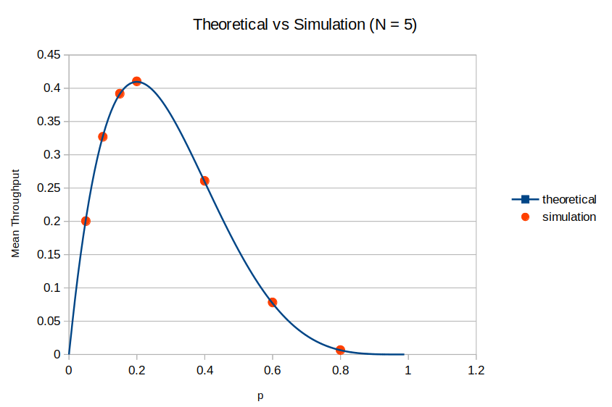

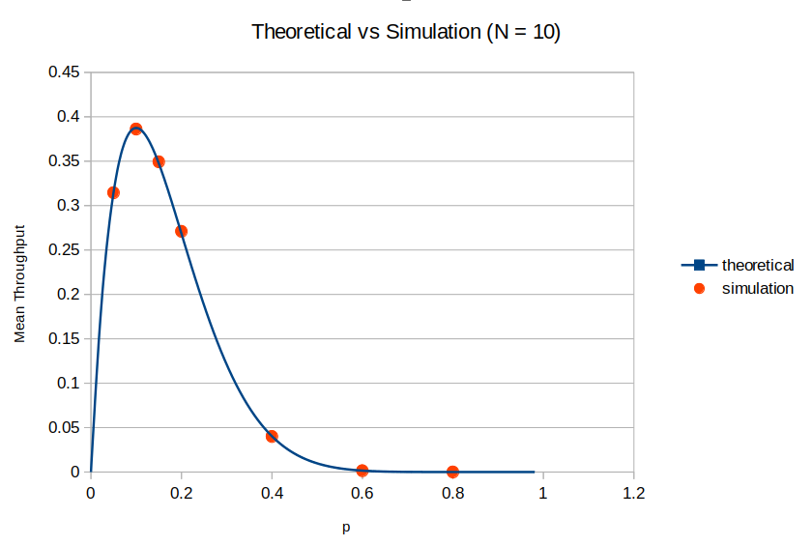
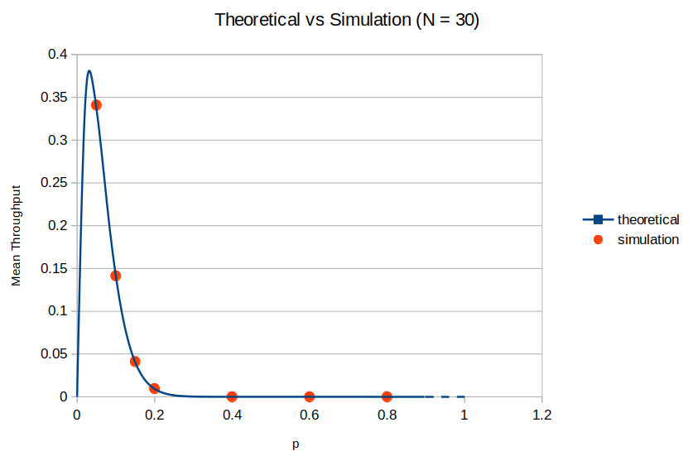

Verification (2)
Collision Model
The probability of a successfull transmission is equal to the probability that only one tx transmit, i.e.:
The latter can be seen as the mean throughput of the system in the single channel case:

Slide 5
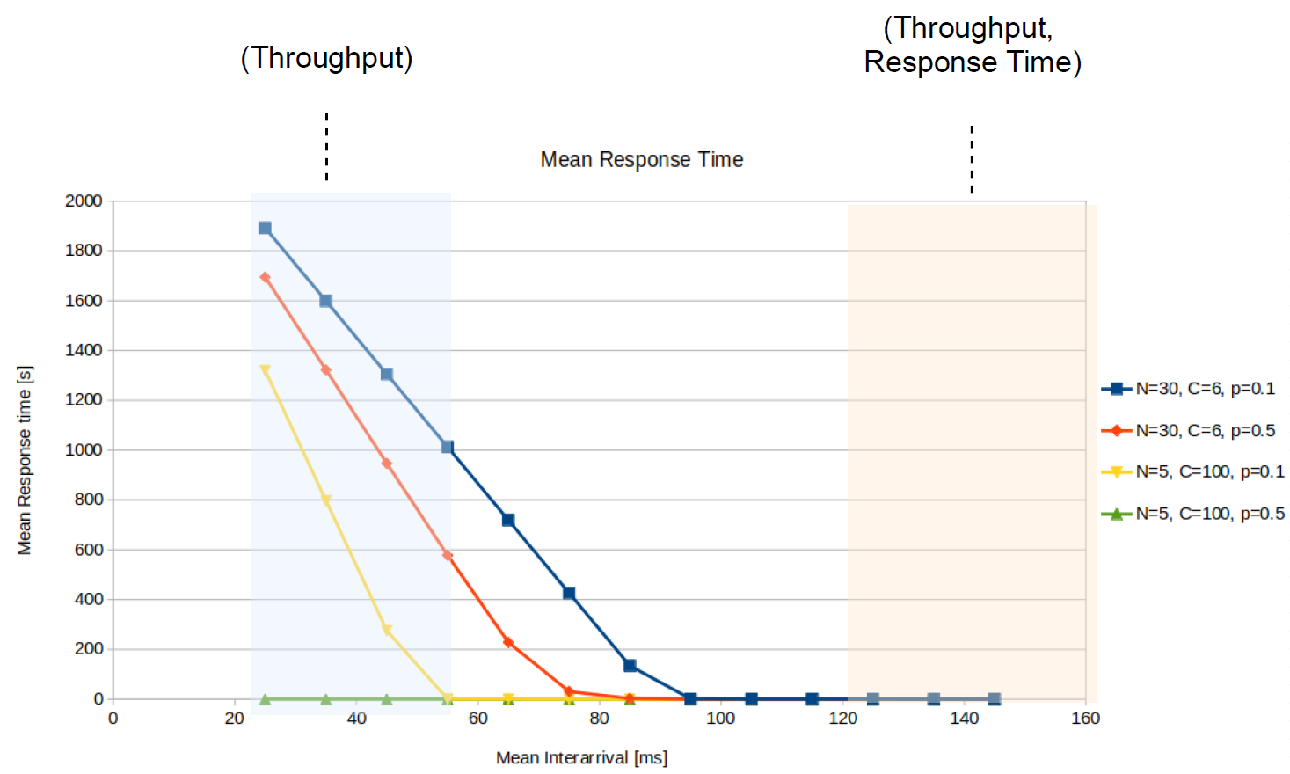
Response Time Limits

Slide 6
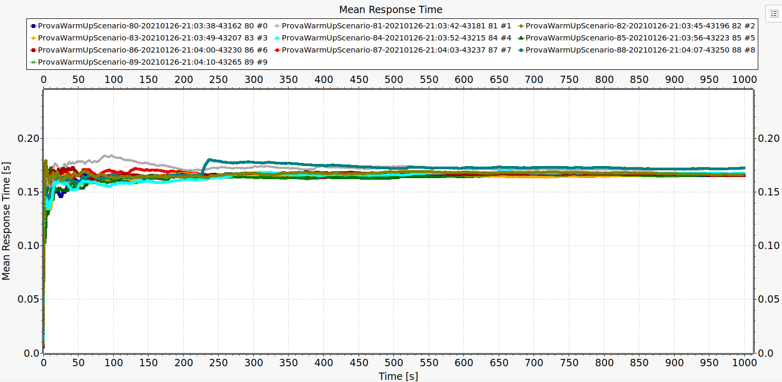
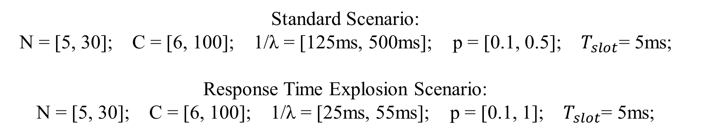
Scenario Calibration
WARMUP:
250s
SIMULATION DURATION:
5000s
Standard Scenario:
N = [5, 30]; C = [6, 100]; 1/λ = [125ms, 500ms]; p = [0.1, 0.5]; $T_{slot}$= 5ms;
Response Time Explosion Scenario:
N = [5, 30]; C = [6, 100]; 1/λ = [25ms, 55ms]; p = [0.1, 1]; $T_{slot}$= 5ms;

Slide 7
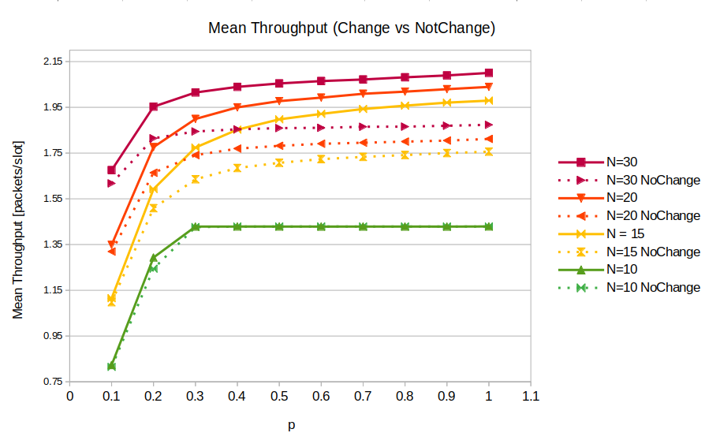
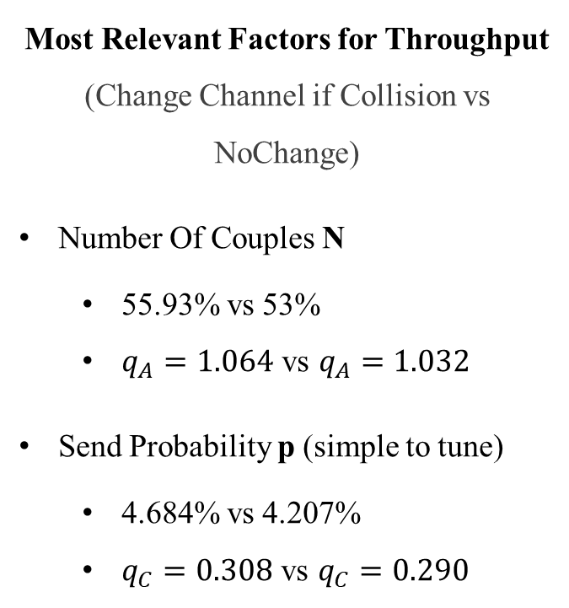
Response Time Explosion Scenario
Most Relevant Factors for Throughput
(Change Channel if Collision vs NoChange)
Number Of Couples N
55.93% vs 53%
$q_{A}=1.064$ vs $q_{A}=1.032$
Send Probability p (simple to tune)
4.684% vs 4.207%
$q_{C}=0.308$ vs $q_{C}=0.290$
(C=6, 1/λ = 35ms)

Slide 8
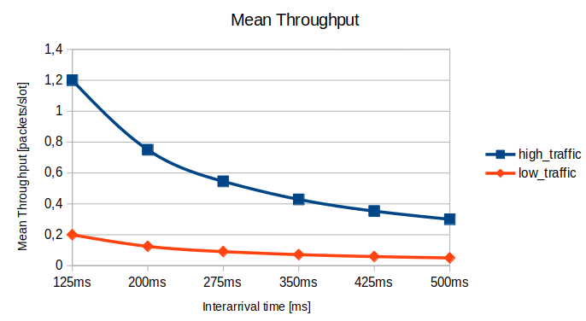
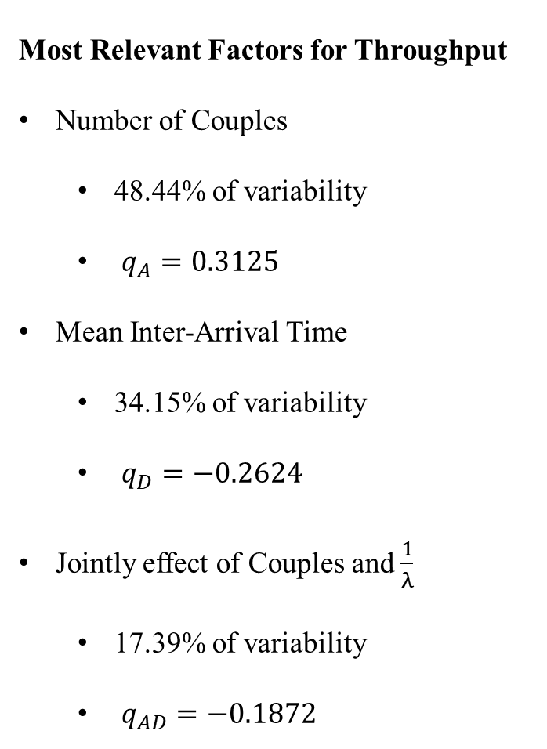
Standard Scenario - Throughput
Most Relevant Factors for Throughput
Number of Couples
48.44% of variability
$q_{A}=0.3125$
Mean Inter-Arrival Time
34.15% of variability
$q_{D}=−0.2624$
Jointly effect of Couples and $\frac{1}{λ}$
17.39% of variability
$q_{AD}=−0.1872$
High Traffic Scenario
N = 30; C = 6; p = 0.1
Low Traffic Scenario
N = 5; C = 100; p=0.1

Slide 9
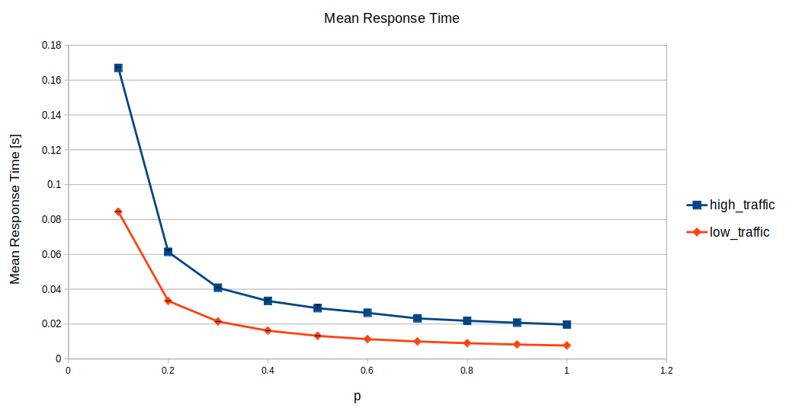
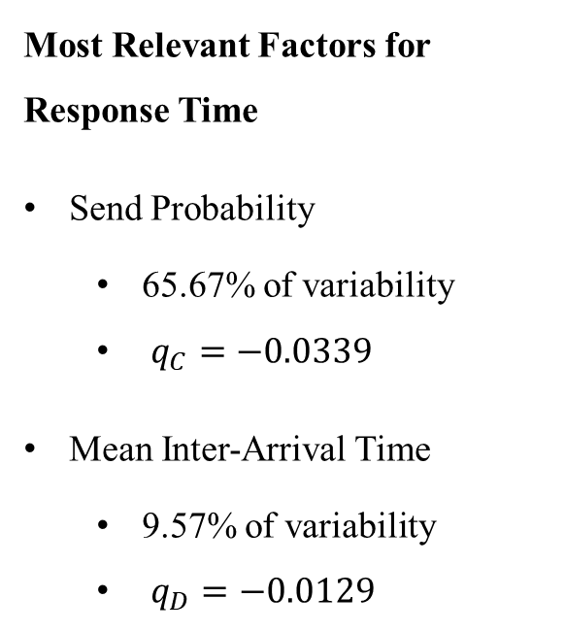
Standard Scenario – Response Time
Most Relevant Factors for Response Time
Send Probability
65.67% of variability
$q_{C}=−0.0339$
Mean Inter-Arrival Time
9.57% of variability
$q_{D}=−0.0129$
High Traffic Scenario: N = 30; C = 6; 1/λ = 125ms
Low Traffic Scenario: N = 5; C = 100; 1/λ = 125ms

Slide 10
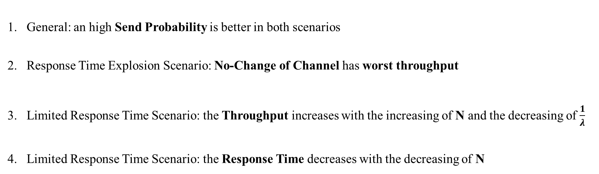
Conclusions
General: an high Send Probability is better in both scenarios
Response Time Explosion Scenario: No-Change of Channel has worst throughput
Limited Response Time Scenario: the Throughput increases with the increasing of N and the decreasing of $\frac{1}{λ}$
Limited Response Time Scenario: the Response Time decreases with the decreasing of N

